Slide 1
GenderStatstics Hive
Mike, Robert, Tyrin

Slide 2
Staging
Imported the Data into hive
At this “Stage” the data is all string values;

Slide 3
Warehouse
A data view was constructed from the staging data
The values were then casted into the proper typing
From here the queries were filtered out

Slide 4
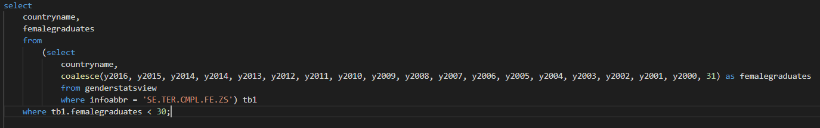
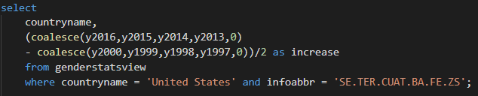
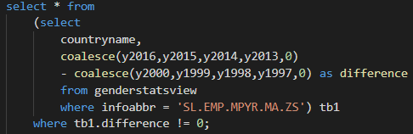
Queries
Query 1: Identify the countries where % of female graduates is less than 30;
Query 2:
List the average increase in female education in the US from the year 2000;
Query 3:
List the % change in male employment from the year 2000;

Slide 5
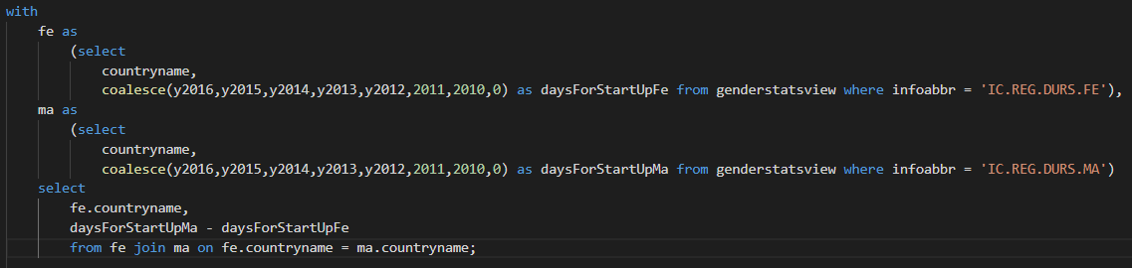
Queries Pt. 2
Query 5:
Getting the number of days required to start a business for males and females in every country;

